Slide 1

Modeling Time Series Data with RNN
Ashit Patel
Jaimin Patel

Slide 2
Introduction
We have Electronics Health Records that contains patient’s several records.
The goal is to improve medical assistance by predicting early signs of illness from existing data.
The main aim of the model is to generate a mortality of any patient at time of interest, from the existing data.
We will accomplish this model by using deep learning network with RNN network.

Slide 3
Data Preparation
Loading data from hdf files.
Data normalization(min-max).
Filling empty data.
Generating sequence by each encounter id
Padding/Truncating data to 90% of overall length.
Training and validation data
80% of training set
20% of validation set

Slide 4
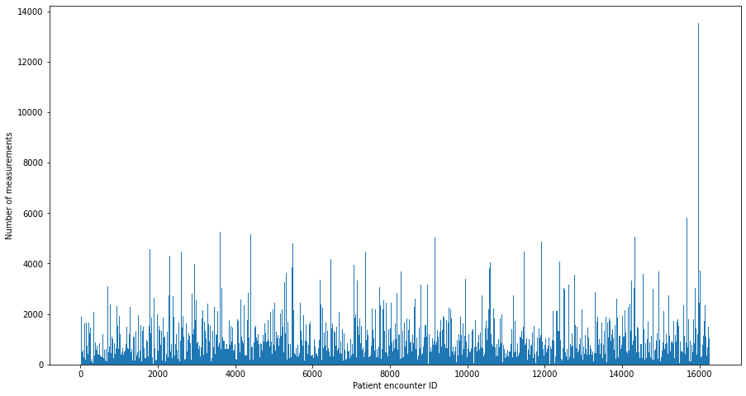
Histogram of number of patient encounter id:
Figure 1

Slide 5
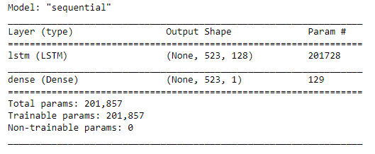
Model
Baseline LSTM model with 1 LSTM layer.
1 Hidden LSTM Layer
Neurons: 128
Input shape: 5000 x 523 x 265
Output shape: 5000, 523,128
1 Output layer
Output neurons: 1
Output shape: 5000 x 523 x 1
Figure 2

Slide 6
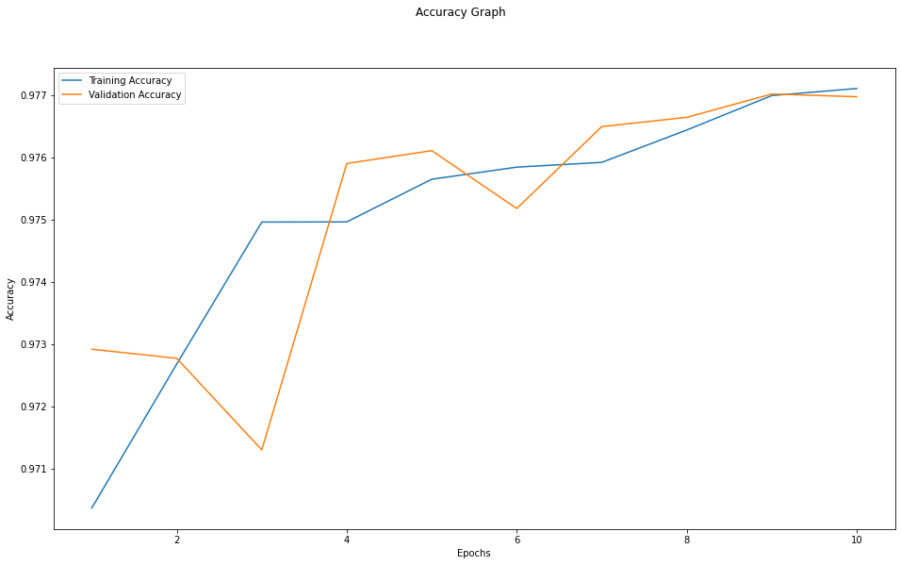
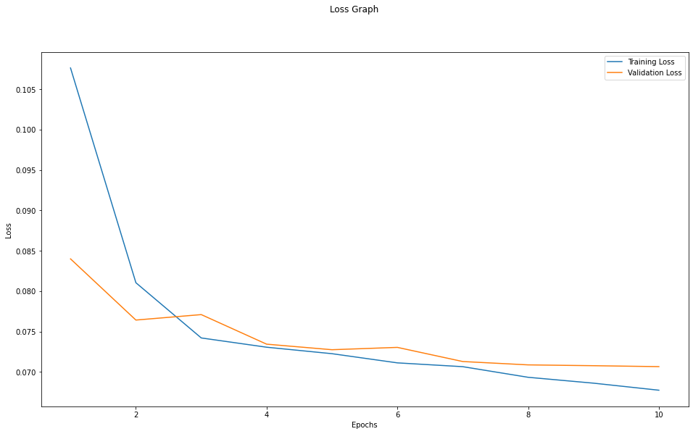
Validation and Testing
Figure 3
Figure 4
Epoch: 10
Training Accuracy: 0.9771
Validation Accuracy: 0.9770
Testing set
Accuracy: 0.9963

Slide 7
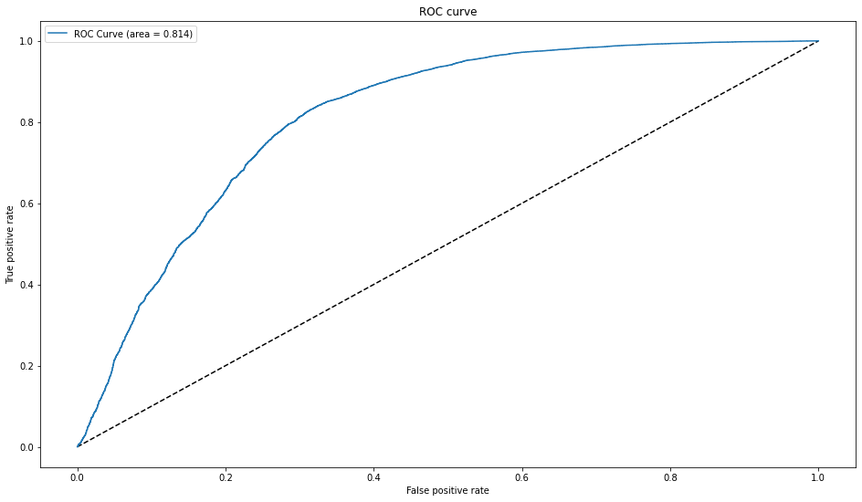
Testing Set after removing padded data:
Accuracy: 0.937
Sensitivity: 0.9870
Precision: 0.9474
AUC score: 0.814
Figure 5

Slide 8
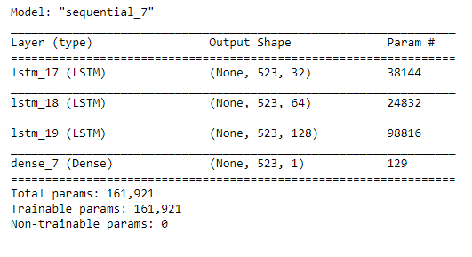
LSTM model with multiple LSTM layers.
1 LSTM Layer
Neurons: 32
Input shape: 5000 x 523 x 265
Output shape: 5000, 523, 32
1 LSTM Layer
Neurons: 64
Input shape: 5000 x 523 x 32
Output shape: 5000, 523, 64
1 LSTM Layer
Neurons: 1280
Input shape: 5000 x 523 x 64
Output shape: 5000, 523, 128
1 Output Layer
Neurons: 1
Input shape: 5000 x 523 x 128
Output shape: 5000, 523, 1
Figure 6

Slide 9
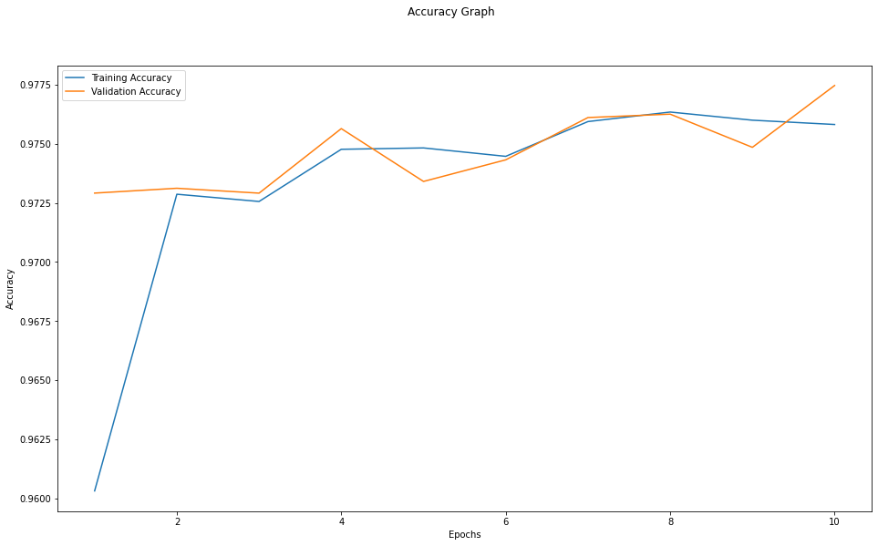
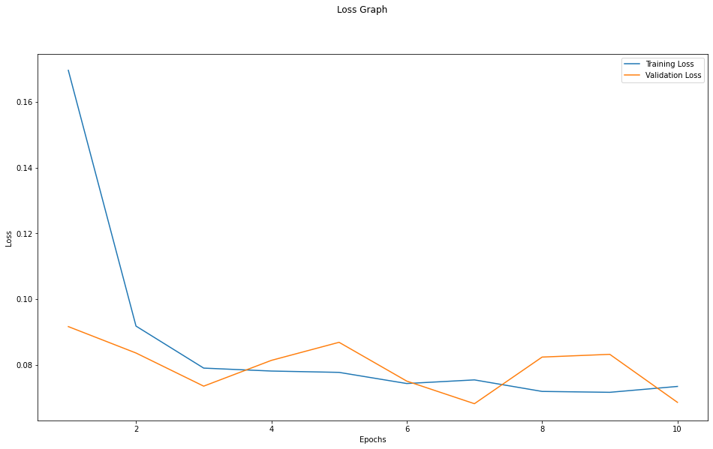
Figure 7
Figure 8
Epoch
Training Accuracy: 0.9758
Validation Accuracy: 0.9775
Testing set
Accuracy: 0.9962

Slide 10
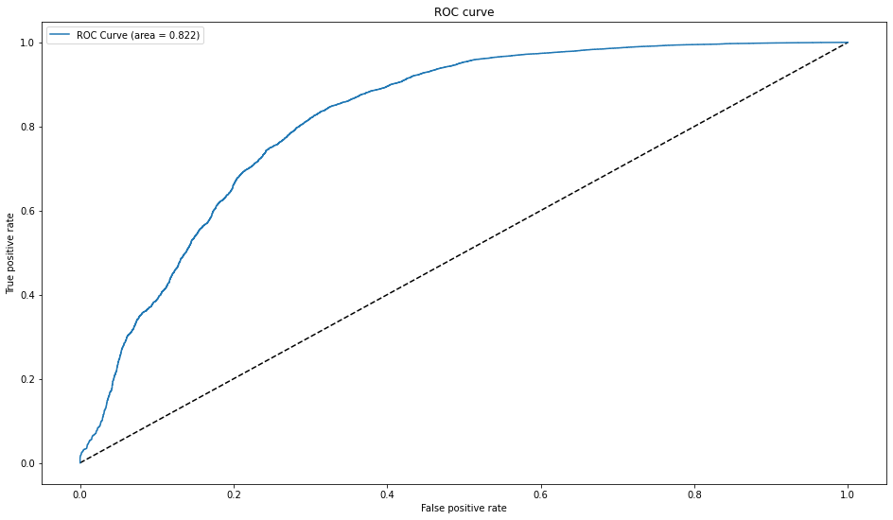
Testing Set after removing padded data:
Accuracy: 0.935
Sensitivity: 0.9784
Precision: 0.9529
AUC score: 0.822
Figure 9

Slide 11
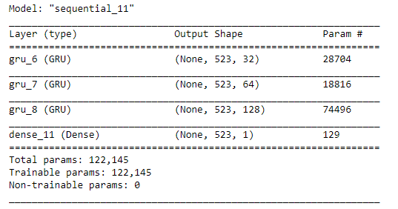
GRU model with multiple GRU layers.
1 GRU Layer
Neurons: 32
Input shape: 5000 x 523 x 265
Output shape: 5000, 523, 32
1 GRU Layer
Neurons: 64
Input shape: 5000 x 523 x 32
Output shape: 5000, 523, 64
1 GRU Layer
Neurons: 1280
Input shape: 5000 x 523 x 64
Output shape: 5000, 523, 128
1 Output Layer
Neurons: 1
Input shape: 5000 x 523 x 128
Output shape: 5000, 523, 1
Figure 10

Slide 12
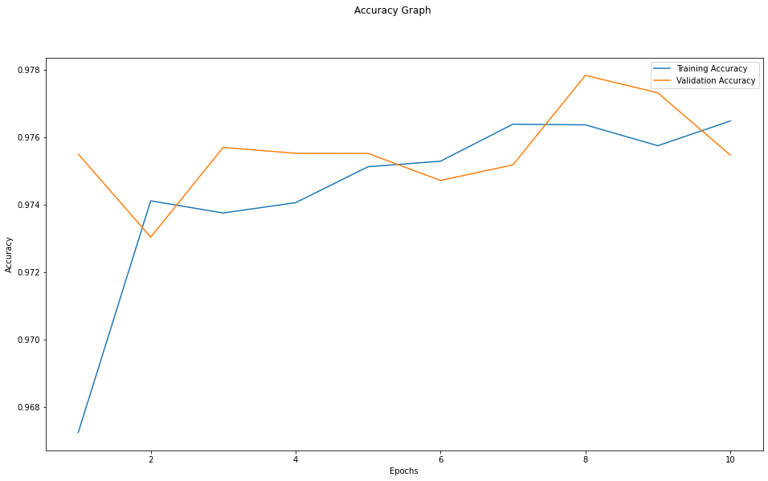
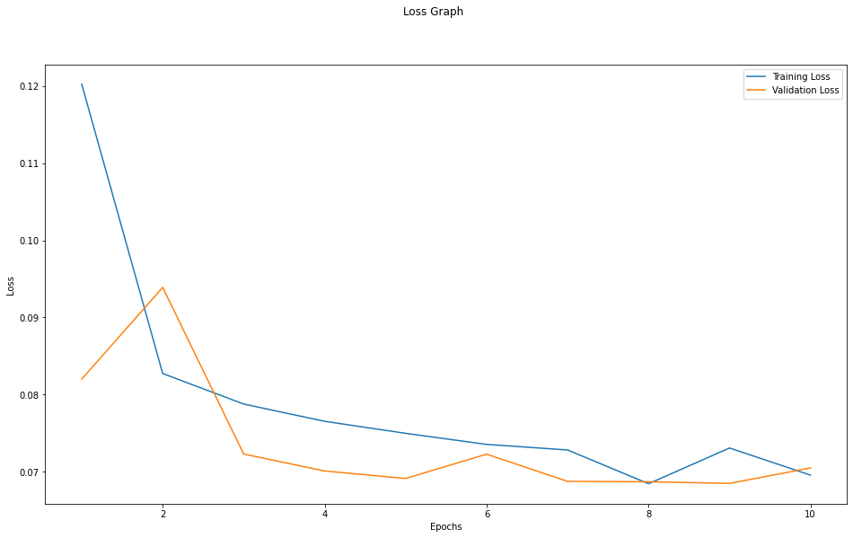
Figure 11
Figure 12
Epoch
Training Accuracy: 0.9765
Validation Accuracy: 0.9755
Testing set
Accuracy: 0.9963

Slide 13
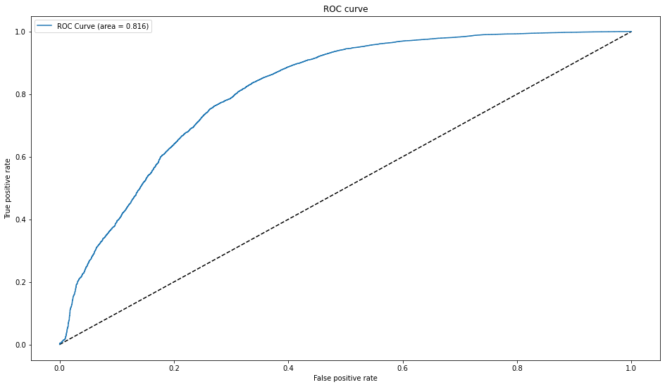
Testing Set after removing padded data:
Accuracy: 0.9366
Sensitivity: 0.99423
Precision: 0.9409
AUC score: 0.816
Figure 13

Slide 14
Predicted set has
Number of dead patient's: 1475
Number of Alive patient's: 80776
While original dataset has
Number of dead patient's: 5800
Number of Alive patient's: 76451

Slide 15
Conclusion
Better Preprocessing.
Use something else instead of padding.
Using advanced RNN layers or multi level input model may improve result.

